Slide 1
GEORGE!!
By Rebecca and Joana

Slide 2
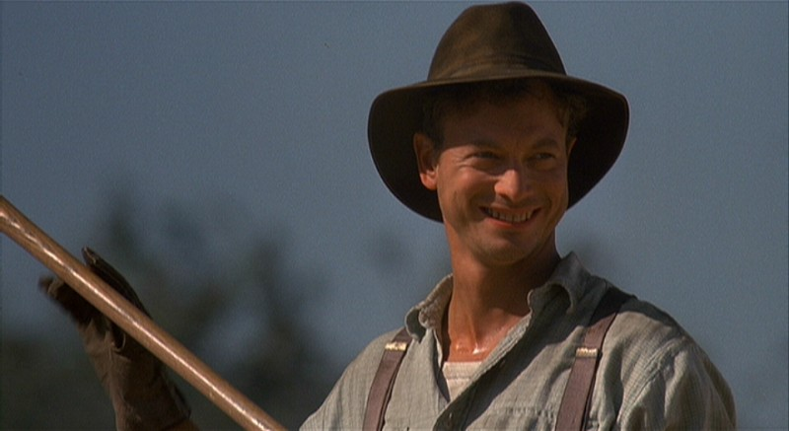
About George
‘The first man was small and quick, dark of face, with restless eyes and sharp, strong features. Every part of him was defined: small, strong hands, slender arms, a thin and bony nose.’
George is a main character in the book. He travels with Lennie, and takes care of him. He is level-headed, and the sensible of the two. He takes the role of Lennie’s parent. He ‘mothers’ him. This is because Lennie wouldn’t survive without him.
‘Blubberin’ like a baby! Jesus Christ! A big guy like you!’

Slide 3
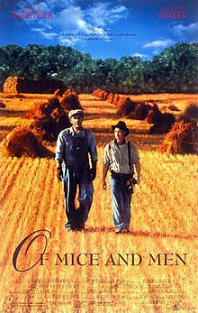
George compared to Lennie
George
lennie
George is mentally strong
‘You know God damn well what. I want that mouse.’
George is physically small
‘The first man was small and quick.’
George makes the decisions
‘I said get him.’
George has power over Lennie
‘Well get the hell out and wash your face.’
George protects Lennie
‘I ain’t gonna let ‘em hurt Lennie.’
Lennie is mentally weak
‘I pinched their heads a little....and then they was dead.’
Lennie is phsically big
‘A huge man, shapeless of face...’
Lennie is pyhsically strong
‘He stood crying, his fist lost in Lennie’s paw.’
Lennie is ‘retarded’
‘The first man stopped short in the clearing, and the follower nearly ran over him.’

Slide 4
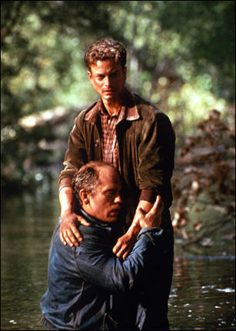
George and Lennie’s relationship
George has taken care of Lennie since his Aunt Clara died.
‘Sure, we kinda look after each other. He ain’t bright. Hell of a good worker, though. Hell of a nice fella, but he ain’t bright. I’ve known him for a long time.’
George leaves Lennie to go to the brothel with the others, showing that he wants to be free from Lennie.
George and Lennie’s relationship is similar to the connection between Candy and his dog. In the end, Lennie and the dog both get shot.
Lennie trusts George.
‘I turns to Lennie and says, “Jump in.” An’ he jumps. Couldn’t swim a stroke.
He damn near drowned before we could get him. An’ he was so damn nice
to me for pullin’ him out. Clean forgot I told him to jump in.’

Slide 5
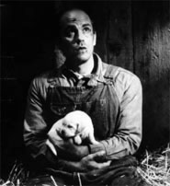
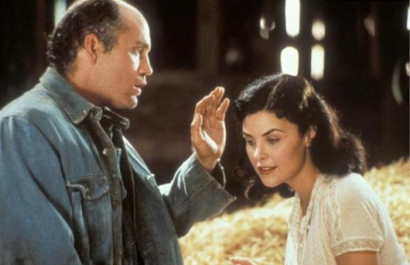
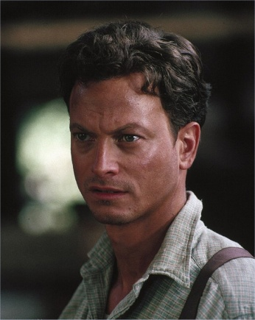
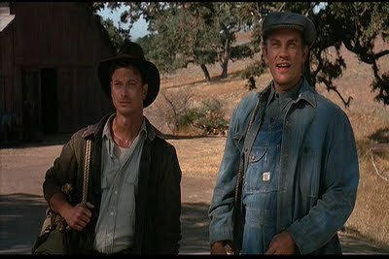
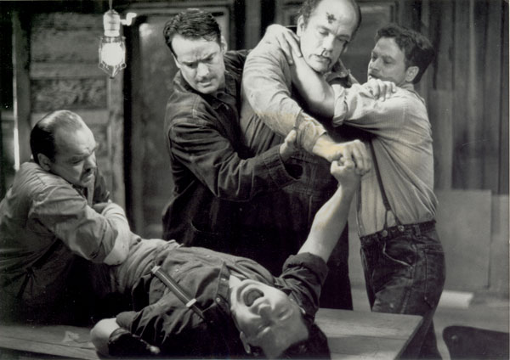
George knows Lennie better than anyone
George’s warning that “Lennie’s strong and quick and Lennie don’t know no rules” is predictive . This is Steinbeck’s warning to the reader that Lennie is a danger to society, and that George knows it, and that despite this, he still let’s Lennie live, until the end.

Slide 6
George confesses to Slim about what happened in Weed
In order for Slim to understand why George and Lennie move around a lot, and to let the reader know what happened in Weed, George confesses to Slim.
‘Well, he seen this girl in a red dress. Dumb bastard like he is, he wants to touch ever’thing he likes. Just wants to feel it. So he reaches out to feel this red dress an’ the girl lets out a squawk, and that gets Lennie all mixed up, and he holds on ‘cause that’s the only thing he can think to do.Well, this girl squawks and squawks. I was jus’ a little bit off, and I heard all the yellin’, so I comes running, an’ by that time Lennie’s so scared all he can think to do is jus’ hold o. I socked him over the head with a fence picket to make him let go ....... Well that girl rabbits in an’ tells the law she been raped. The guys in Weed start a party out to lynch Lennie. So we sit in irrigation ditch under water all the rest of that day.... He just scared her. I’d be scared too if he grabbed me. But he never hurt her. He jus’ want to touch that red dress, like he wants to pet them pups all the time.’

