Slide 1
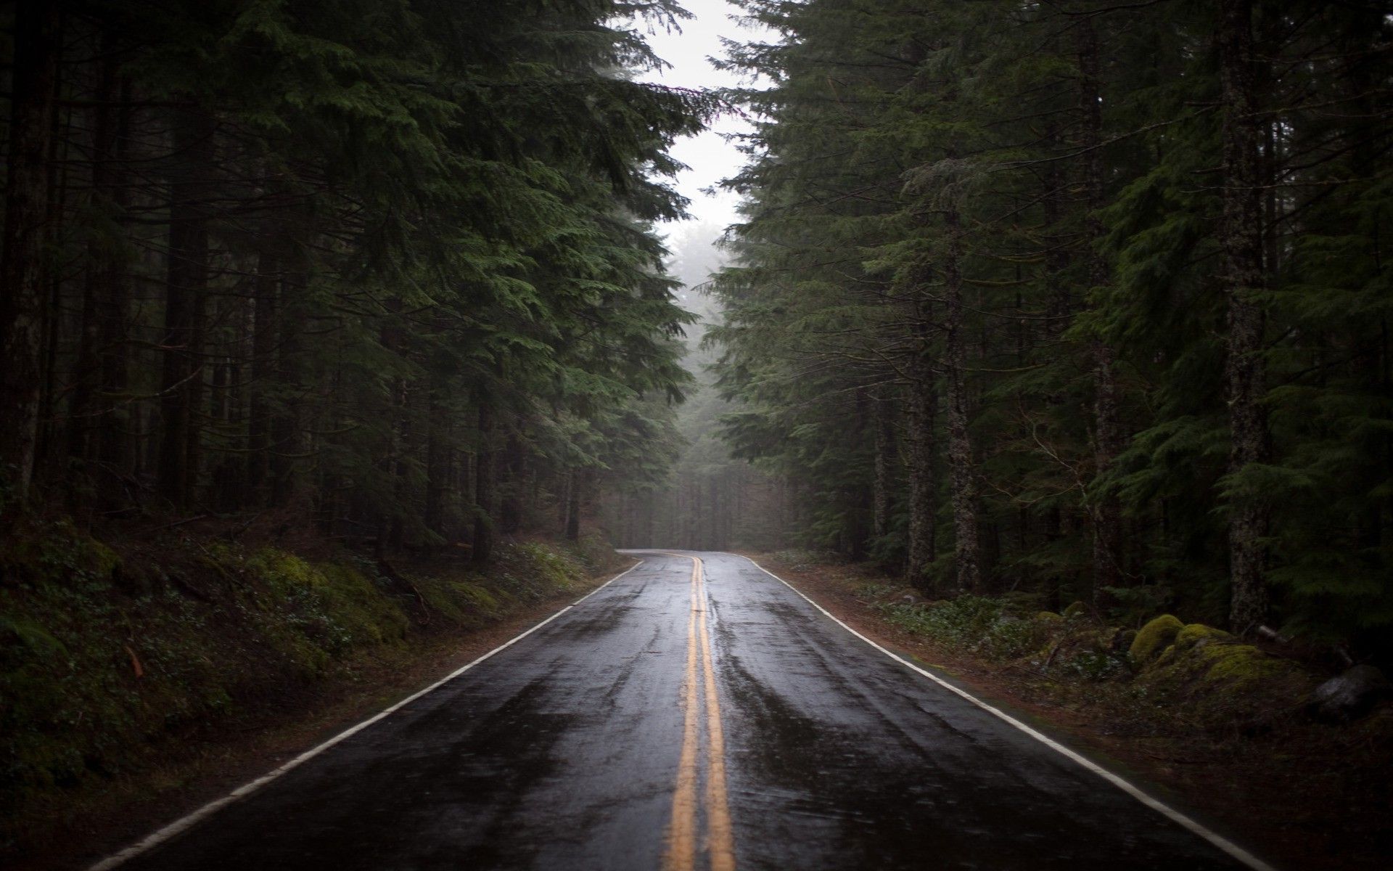

Part 1 Introduction
Not again! Cruising happily in your car, all had seemed well. That was until the storm had started. The rain lashed down like angry buckets hurled by a vicious giant.
It was too much. You lost control of your car and slid it into a ditch. It won’t start. The only way to get help is to get out and try to walk for help…
You leave the car and began to walk to slide 2

Slide 2
Part 1: Getting into the house 2
You are sodden, and feeling miserably wet.
Soon the looming hulk of a house rises on the horizon, its wooden bulk calling free shelter to you. The sky calls back with a crack of thunder, and lightning strikes! You do not know if you will make it to the house so easily! Do you…
You run towards the house?
You hide under a tree ?

Slide 3
Part 1: Getting into the house 3
As you tread out of your vehicle, you find yourself engulfed by darkness that closes in from all sides like dark predators surrounding their prey. The blinding moon hovers above, almost like a flash light, creating a path towards the house.
You move to the house, safe.

Slide 4
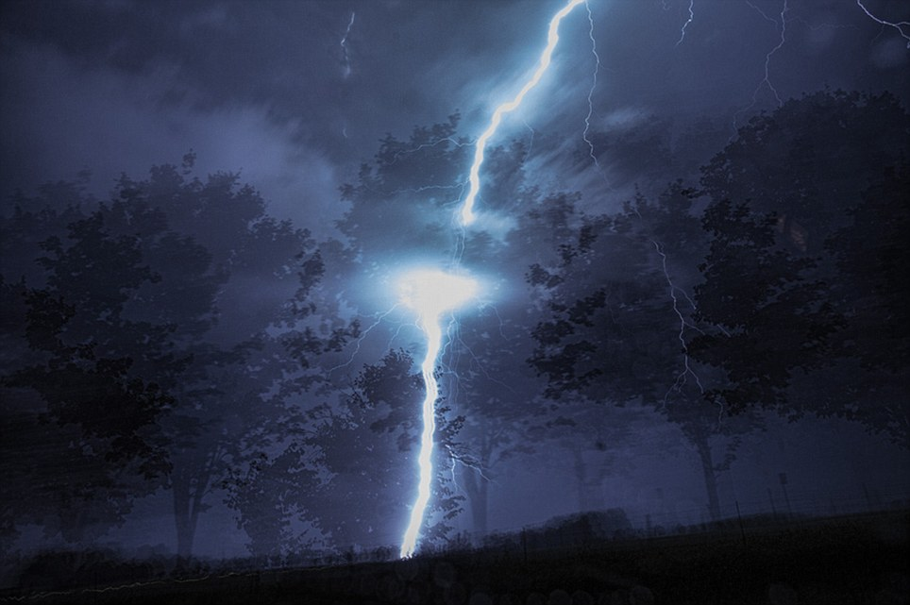
Part 1: Getting into the house 4
You retreat to the tree.
Lightning strikes.
The crack of electricity is the last thing you hear…

Slide 5
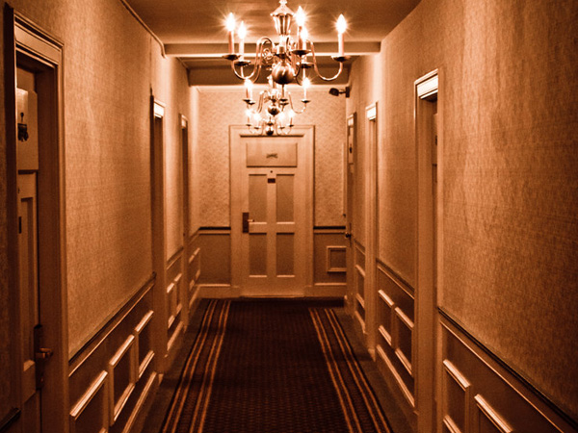
Part 1: Getting into the house 5
Dusty antique chandeliers hang from the sealing covered in spider webs. There are old tables and a torn up carpet in the middle of the room. The wind coming from the shattered window brushes your hair to the sides revealing your pale face. Your heart is racing.
You can hear it through your chest, overtaking your mind with the constant thump. Thump. Thump.
Move to slide 6, the hallway

Slide 6
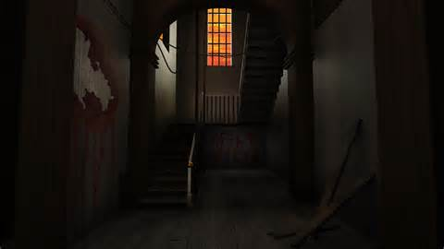
Part 2: Hall 6
The grime of the hall seems to jump in the air like fleas from a dangerous dog. Towards you is an open kitchen, the kitchen knives glinting like a cheeky eye. A set of ornamental stairs winds upwards like a curling snake.
A living room, darkened by filthy curtains, is just off to the left.
Move to the Kitchen, slide 8.
Move to the stairs, slide 10
Move to the living room, slide 13
Move to the cellar, slide 16

Slide 7
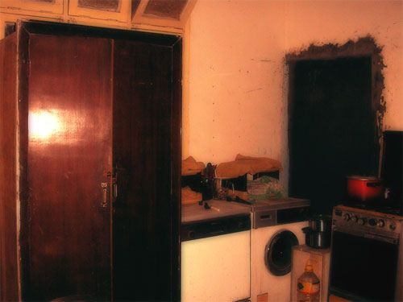
Part 2: Kitchen 7: Kitchen Cupboard
It seems like the sounds round you are creeping louder. Listen. You can hear the rotten floorboards flooding the room with creaks; this is what horror movies are about. Snapping back into that strange reality, you find yourself in the kitchen. Whilst scanning the room, on the countertop you glare at a pile of six or seven knives, larger than usual. Your feet start to step towards them: it was almost automatic. You look down onto them and see that the biggest one – unnaturally big – has many drops of blood on it. Where from? Is it human blood? You think of so many questions, anxious, terrified, and confused.
Go back to kitchen entrance, slide 8
Go to kitchen window, slide 9
Go to hallway, slide6

Slide 8
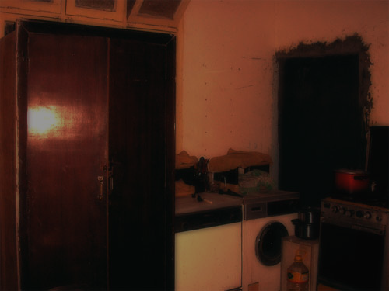
Part 2: Kitchen 8: Kitchen Entrance
As you look away from the knives, you slowly move your head over to a pile of class on the countertop.
Your head shifts up to a window; well what’s left of a window anyway. You roll your finger over one of the sharp edges. Stupid. Blood starts to trickle down it but you throw it your mouth to stop the bleeding.
Crunching underneath my feet, the glass makes you stumble back. What made this hole? Did someone try to escape? There is nothing here.
Go back to kitchen cupboard, slide 7
Go to kitchen window, slide 9
Go to hallway, slide6

Slide 9
Part 2: Kitchen 9: Kitchen Window
You look around in the charcoal scene surrounding you. Your gaze penetrates through the window which is letting the only beam of light in.
You slowly and carefully tread towards it. You see quick shadows scrambling to safety. Your stare stops all of a sudden you see a silhouette of a man standing. However when you look back the shadow has vanished. You catch a glimpse of a tree swaying furiously – outraged and about to strike. You can now hear the thunder rumbling in bitterness. You can see the lightning as it fractures the sky in pieces like it was made out of clay. The wind silently weeping as it blows away. You see the leaves strategically planning where to fall. Now you can hear a soothing whistle that comes from the bleak bushes. You try to investigate. Nothing. You gradually return to the opaque scene.
Go to kitchen cupboard, slide 7
Go to kitchen entrance slide 8
Go to hallway, slide6

Slide 10
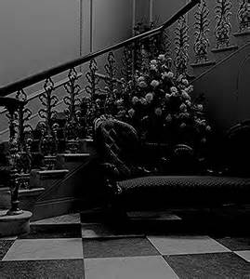
Part 3: Stairs 10: Bottom of Stairs
Finally at the bottom of the stairs you exhale all the horrid things you saw. You ask yourself where you landed and you are doing here. Under you something is being slammed closed and pulled open with a creek. You jump up in horror because you know the house is not finished with you.
So you check what is going on under your feet. The think what was slamming was an old rusty door which didn’t move at all. At this you freak out because you don’t know what was moving the door - no wind was blowing down there.
Looking down on the floor you jump up and almost faint. On the floor blood is spreading and trying to grab you by your ankle. In shock you look up and find a message written on the door:
“if you dare enter you will never come out alive!”
Go to the top of the stairs, 11
Look under stairs cupboard, 12
Go to hallway, slide6

Slide 11
Part 3: Stairs 11: Top of stairs
As you rush to the top of the stairs, you hear a noise. There must be something ahead, you think. It cannot be good. It definitely cannot be good. Nothing good can come out of this deserted, defunct house. You decide to look up…
You scream. You see something to show this house is definitely haunted – or at least just belonging to some elderly psychopath. Blades swing from side to side near the top of the stairs – it would be dangerous to continue. On the top of the stairs, you notice blood. It looks fresh… You decide to head back down, but to where? What would going back to Square One achieve?
Then you realize it. There’s a door below the stairs. Worn with age, it appears to be dark and dreary. What possibilities lie behind that door? What dangers? The blades almost killed you, and who knows what could be down there? Maybe you should just return to the hallway?
The blades swing swiftly behind you. It’s time to make a choice. Do you…
Go to the bottom of stairs, 10
Look under stairs cupboard, 12
Go to hallway, slide6

Slide 12
Part 3: Stairs 12: Stairs under the stairs
As you push open the door, it creaks. It feels like the door has not been touched in a long time, yet the air isn’t musty. Could someone have entered recently? You see what appears to be a freshly lit lamp in the corner…
You turn your head leftwards. What’s that? A key? And a piece of paper? What’s this? You pick up the paper slowly… You decide to read it. The paper cracks as you hold it. Maybe you should place it down…
“Dear diary…
I have left the keys I have found in safe places. For twenty years I have been struggling to leave. Twenty years. My time is almost up, and this body is expiring. I grow wearier as I write this. Wearier. I have not solved the mystery of this house. To god I pray no one else will inherit this fate I have been given…
The cellar I was planning to explore. It seems to be the key out, but I can sense hidden dangers there. Alas, I have grown too old…”
The letter ends with an unrecognisable scrawl. The only word recognisable is choice…
A choice, you think? A choice? What choice? You decide to take the key. However, it is extremely heavy. You will grow weary and fatigued if you take more than one. If you already have a key, you will need to abandon it if you want this one..
There is also a piece of bread in the room. It does not seem rotten…
You take the silver key.
Go to the bottom of stairs, 10
Go to top of stairs, 11
Go to hallway, slide6

Slide 13
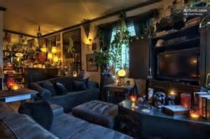
Part 4: Living Room 13: Living Room Entrance
It was quiet. It was still. It was cold. Feeling nothing but goose bumps spreading across your body, you tiptoe onto the wooden floor, the chandelier came crashing down before your eyes. Glass scattered everywhere. Spelling something. Bending down to a take a closer look, a shiver crawls up your spine as you realized that it spells… YOU’RE NEXT.
After you stand up with nothing but fear, the television turns on. Then off. Then on again.
Standing there hopelessly, with your heart pounding out of your chest, you glance to where the lighting struck that very moment. There lies waiting a sofa. A sofa with death all over it. Making you move towards it. You make every so step precise as if one step could lead you to hell. You are standing so close to it, you can feel its coldness placed over you.
As your curiosity grows, knowing you shouldn’t be touching anything, you smell fresh blood behind the ripped pillow, so fresh as if someone was bleeding this very moment. Taking a closer look, a small blade peeks out from the fresh smell of blood As you gently picked up the ripped pillow… a dagger lays there. Observing you. Waiting for you. Taking a small shower in fresh blood, it stole from something, or even someone.
The lighting strikes again. As it struck, a shadow had appeared behind the destroyed curtains. Curtains so dangerous, yet so simple. Making your way towards it, something touches you on the shoulder.
Look behind the sofas, 14
Look behind curtains, 15
Go to hallway, slide6

Slide 14
Part 2: Living Room 14: Behind the sofas
Behind the sofas is nothing more than a mouldy pile of discarded pizza boxes. Plasticky cheese strings the lid like long-dead insects.
You don’t feel hungry any more.
What do you do next?
Go back to living room entrance, 13
Look behind curtains, 15
Go to hallway, slide6

Slide 15
Part 2: Living Room 15: Behind the curtains
Outside the curtains you can see little but the beating rain. You feel compelled to force open the window.
You cannot. It is stuck. You stop trying; the panic inside you slowly rising. However, you notice a hidden pit that has opened outside the front door. That might be important.
Do you:
Look behind the sofas, 14
Go to the living room entrance, 13
Go to hallway, slide6

Slide 16
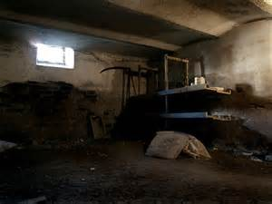
Part 5: Cellar 16 Entrance
Each careful tread of your still-wet shoes breaks a cloud of dust from the stony steps into the cellar. You jerk a light on. The grim dim barely lights the sight before you. You can see some things though: to the left is an old trunk, perhaps once taken on a holiday. To the right is a tool station, complete with hammers, nails and saws. Bizarrely, straight ahead of you is an old, rusted bathtub with what seems to be an amount of freshly drawn water…
Look inside the old trunk, 17
Go to the tool station, 20
Look inside the old bathtub, slide 23
Go to hallway, slide6
Attempt to escape, slide 26

Slide 17
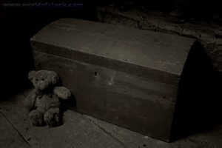
Part 5: Cellar 17: Old Trunk
You’re in a dark, lonely and abandoned cellar. Looking around, wondering what you’re doing down here, why you even entered this house! You’re slowly sneaking down the squeaking wooden stairs. Holding onto the handrail but immediately letting go because of the old and gooey spider webs. Slowly wondering and looking around for any source of light in the room. As you touch the floor again, you stop. You’re terrified of what possible things could jump out of nowhere and scare you to death. Suddenly, you stop moving and get attracted to something, in the far corner of the room. Not an animal, not money, no nothing that would usually catch your attention. An old trunk. Yes, just a normal old trunk.
Pick up the ancient music box, bad choice to 19
Pick up the ancient book, good choice 18
Move back to the cellar, slide 16

Slide 18
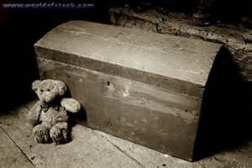
Part 5: Cellar 18: Old Trunk and Ancient Book
You open the book.
Strangely, there is nothing inside. However, it looks to be old and well-thumbed.
You put the book back where you found it.
Move back to the cellar, slide 16

Slide 19
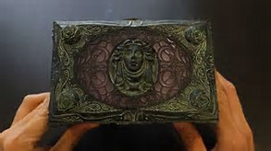
Part 5: Cellar 19: Old Trunk and Music Box: Bad ending
You open the old music box.
A face begins to move.
You fall backwards in terror, or at least you try to do so.
You listen to a song that will never end.
Your journey ends here.

Slide 20
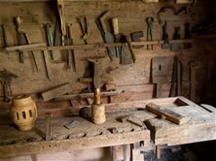
Part 6: Cellar 20: Tool Station
I looked to my left and there I saw some dark wooden stairs. I tip toed to them, still horrified from the previous events. I went down step by step, hoping to get out of this terrifying place. I finally reached the cellar, relieved and before me I spotted a tool table.
It was peculiar because there one only one tool… A hammer. The darkened head topped the splintered wooden handle. It seems to emit a horrible cold cloak of repellence.
The desk is covered in light dust. Will you…
Pick up the hammer? 21
Wipe the dust off the desk? 22
Move back to the cellar, slide 16

Slide 21
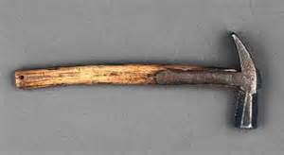
Part 6: Cellar 21: Picking up the hammer bad ending
You slowly walk to it, hoping for no more horrid surprises. You look around. It is a dark, scary cellar and the wooden floors creak with every step you take. You then reach the table.
You stand there wondering whether you should pick the hammer up or not… you do. It slips out of your hands because of some weird slippery oil.
The floors immediately break and you fall down, terrified. You can’t breath you are so scared. You begin to fall asleep.
Your story ends here.

Slide 22
Part 6: Cellar 22: Wiping dust off desk
As you slowly creep down into the dark and mysterious cellar, you notice the cobwebs and rats dotted around the place. Everywhere is pitch black except for one hint of light shining upon a table.
It seems rather frightening down here so you decide to leave, but when you turn around you can’t seem to see where you came from. It is too dark. But in the distance, you can see a strange door. You decided to run towards it to leave but when you arrive, the door is locked. You don’t know what to do. You are trapped. You run towards the only other thing you can see: the table.
You look carefully at the table and all you can see is dust and cobwebs. You brush away the dust and you notice a rather strange looking piece of wood that seems to be wobbly so you pick it up, blow away the dust and underneath is a key. A KEY!! You then realise that this may open the door!
So I ran to the door put the key inside. It fits! I turned the key; one hatch unlocks. I turn it again; another unlocks. Then I turn it one last time and I’m free!!!! I’m out of the scary cellar!
Move back to the cellar, slide 16

Slide 23
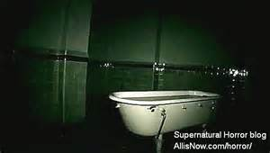
Part 7: Cellar 23: Bathtub
The filthy bathtub squats in the a darkened corner of the cellar, its dampness almost throbbing in the wood around it.
Do you attempt to grasp the dirty grime of the plug to yank out the grimy water within?
Your other choice to is to turn on the tap to see if glistening water might wash away the dirt.
Pull the plug? 25
Turn on more water? 24
Move back to the cellar, slide 16

Slide 24
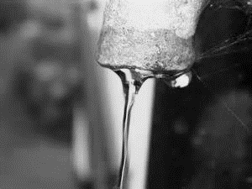
Part 7: Cellar 24: Turn on more water
The water starts up again. Plop. Plop. Plop. The water hardly flows.
You notice something stuck in the tap. Ah! You think to yourself. There is the culprit! What could it be? It looks wrinkled. You gaze at it in horror. A finger!
Leaving the finger, you notice a strange doll, lying in a Victorian dress, next to the tub. Her pale skin glows in the darkness. You almost hard floor when you see what's sprawled across her Victorian frock. “Touch me and die” is written in what looks like blood. A saw is on her lap.
Under the doll you find a silver key. You take it, and leave hastily.
Move back to the cellar, slide 16

Slide 25
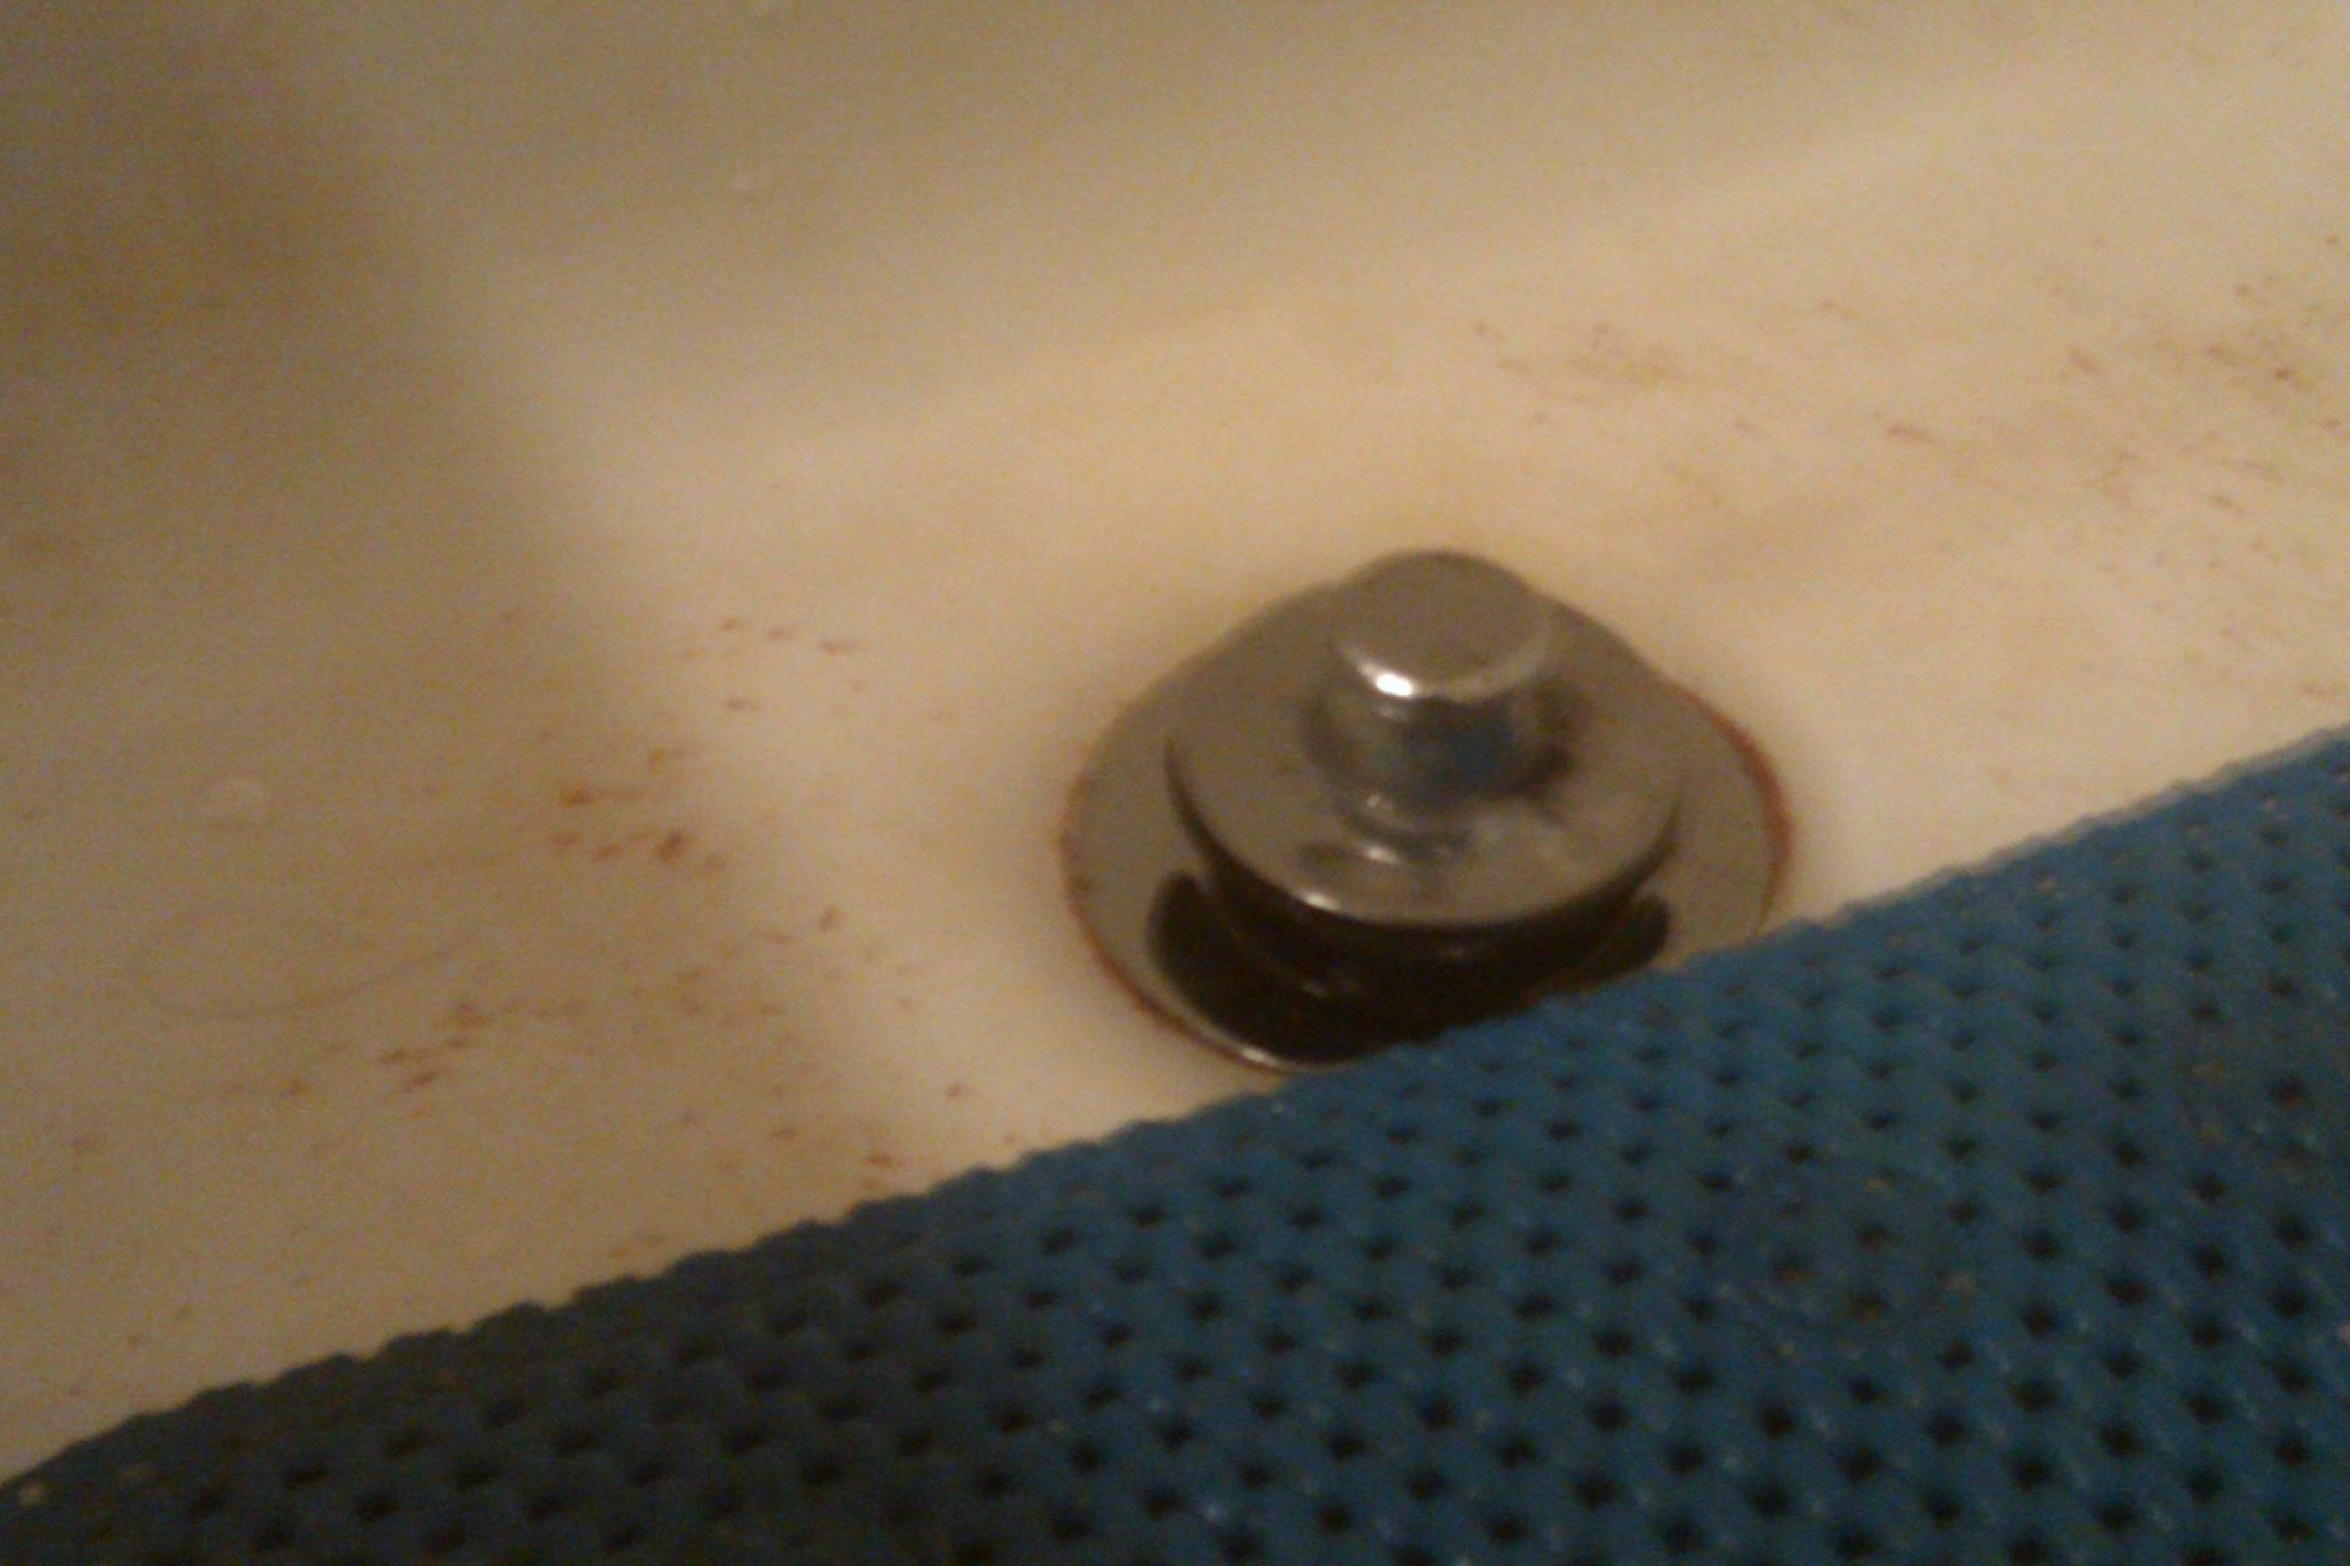
Part 7: Cellar 25: Pull the plug bad ending
The plug is ancient – years, maybe centuries of grime had built up on the handle. This gave it a sickening, slimy feel. You pull the plug with so much force the plug looks like it’s going to disintegrate. The sound of the drainage is deafening – something akin to a continuous rumble of thunder. A massive whirlpool has formed above the drain, turning the contents of the tub into a dark, churning mass.
Shaking violently, the tub growls. You step back amid fears it would break or topple over. It is no use; the bathtub explodes with the force of a bomb. You get blasted against the wall and feel your hand rest on something soft. It is a doll.
Your journey ends here.

Slide 26
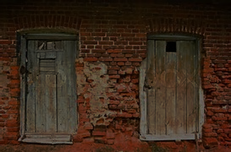
Part 8: Escape 26
As you decide to escape, you come to a door. It leads in a room where there are two doors.
One way requires you to brush past what looks like a Victorian frock, old musty dust clinging to it. The door past it is open. The way inside is darkened…
The other requires you to climb over a table towards a closed door with a bright blue handle. Do you…
Push past the frock to go through the door? go to 27
Push the bright blue handle? Go to 28

Slide 27
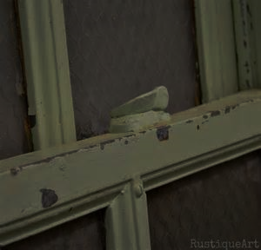
Part 8: Escape 27: Bad Ending
You take a few fast but quiet breaths as you brush past the Victorian frock. You stop until you hear a noise.
The woman is following you.
You turn around quickly till you see a women with a dark coat and golden hair but you don’t see her face. You start pinching your skin in hopes that you are just dreaming- but you’re not. You’re awake and in a dark room with no exit.
You hear the sound of her coming nearer.
You’re getting more worried. Every second passes by like dynamite… but the noise doesn’t go away. In fact, it gets louder. It’s pain for your ears and every single other organ in your body. You run faster, fast enough to hear echoes of your own footprints. You stop and take out the keys from your pocket. Desperately you start looking for a door. Any door.
You find none.

Slide 28
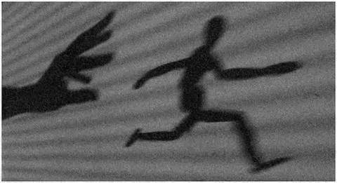
Part 8: Escape 28: Good choice leading to an option
Carefully, you tread lightly along the seemingly never-ending corridor, trying to find a way out of this frightening, bizarre house.
Keeping your head down, its not until halfway through that you realize there are two objects lying a few meters away from you. They look like.... shoes. Shoes attached to a silhouette.
A silhouette attached to a weapon.
Run. Run! Your instincts scream and your legs obey as you turn from your gold haired admirer, two pairs of feet pounding the collapsing floorboards.
You do stop to try to open one of the windows with some keys you have in your pockets? Or do you try to slam the doors closed as you flee?
Slam the doors? to 29
Open one of the windows? to 30

Slide 29
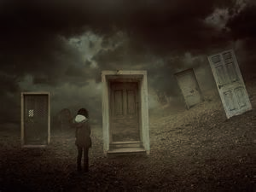
Part 8: Escape 29: Bad choice end of story
You try to find a window to open. You can’t.
Strong menacing sounds erupt from the hall. Gasping, you whip around only to come face to face with a dark shadow wearing a Victorian dress with stroking her beautiful golden hair.
Oh, and holding a weapon.
You start running and immediately your pounding footsteps echo down the hall as you try to escape the monster hunting you. You don’t care where the winding path leads, opening locked doors with fumbling hands, trying to find the right key. Twisting and turning your way blindly through the house.
Until a wall is staring blankly back.
Your journey ends here.

Slide 30
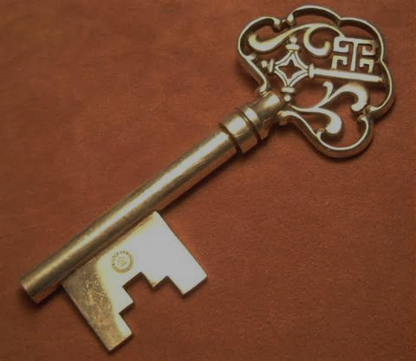
Part 9: Ending 30: Good choice, leads to three possible endings
As you flee down countless corridors, you manage to flee from the monster. You are about to leave the house. Do you…
Have a silver key?
Have a silver key, and turned on water in the bathtub?
Have a silver key, and turned on water in the bathtub, and looked out the window of the kitchen?
Bad ending, didn’t choose any good options from before, 31
Normal ending, found something from some good options, 32
Great ending, found much from good options, 33

Slide 31
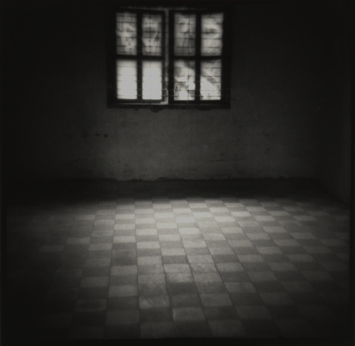
Part 31: Ending 31: Bad Ending
Straight away you realise that you’ve made a mistake; you turn to run but the door you came in through is gone. You’re trapped.
Trying to scream – you have no voice. Panic overwhelms you and you fall to your knees. You bury your face into your hands, covering the tears you can’t control. Whispers, you hear whispers.
The room is empty apart from a small red light hanging off the ceiling. Your only light source. Your lifeline. You walk towards it but with every step you take it becomes more distant.
“Confused?” A sudden voice bounces off the walls and into your thoughts.
“Where am I? What is this? Let me out!” You finally have a voice, and it’s angry.
“Some might call it…how do I put this…how…ah. Got the word. Hell!” The voice bursts into a high pitched laughter and is cut off by a loud buzzing sound. You look around and in the distance you see a chair, the kind of chair you would find in a dentist’s office. Out of curiosity you walk towards it.
Something tightens around your left wrist and you shriek, “Ah!?” Your eyes find your hands, around your wrist there is a tight strap that is connected to the chair. Then something grabs your right hand, “You have such lovely fingers…to bad I was ordered to remove them. But oh well, you won’t need them here. After all, this is your home…forever.” A white haired man, with black sockets for eyes, grins.
A scream. Not yours but the man’s fills the room. You look around but all you see is darkness. The chair is gone. So is the man. Something taps you on the shoulder.
You turn.
Your journey ends here

Slide 32
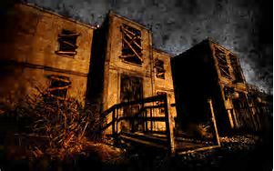
Part 32: Ending 32: Normal Ending
With the key you manage to escape.
You step outside, avoiding the growing army of Victorian frocks seemingly pressed up against the windows. You are free.
After a short while running, you’re leaning against a large tree and your leg is killing you, you cut it against a branch just moments ago. Your breath is heavy and rough, “Why is this happening?” You whisper to yourself but you can’t think of an answer.
You hear a snap, the sound of a twig breaking under pressure. She must be near. A sudden pain shoots up your spine, it has to be your leg but you don’t dare to look down.
“Come out, come out wherever you are. I don’t feel like playing.” An empty voice snaps. You almost scream. It’s her.
Before you realise it, you’re running.
The world around you becomes a blur. Smudged.
Breathing is becoming harder by the second but you limp forward. Abruptly, you stop. You turn to face your fear. She’s not there.
You turn to stumble. Have you escaped? It depends how fast you can walk…
Your story ends here…

Slide 33

Part 33: Ending 33: Great Ending
You’re gasping for breath, your hand pressed against your stomach. Calm down.
Leaning against the large tree you feel safe like its protecting you: but it’s not and you’re still in danger.
A twig snaps and your hand is on your mouth. Silence. The silence is almost painful and you shiver at the thought that the woman could be behind you.
Nothing happens. You build up the courage to look back – you shut your eyes. “One.” You whisper, “Two…three.” You swing your body to the left and your eyes widen. “Bike!” You burst into tears as you scramble towards the bike that is leaning against a distant tree. Your feet tread the muddy ground in odd uneven steps. Your legs are failing but you keep going, you have to survive.
Now you’ve reached the bike but you feel weak, unable to move. The adrenaline that got you this far is fading and the pain overwhelms you; you’re tired, you’re hungry and you’re giving up.
You hear it – a shout from the monster following you. You look up only to see a figure closing in. Fifty metres away. You pull yourself up in a desperate struggle. Twenty metres. You grab the bike and pull it towards you, your muscles aching. Ten metres. You leap on, plunge your feet onto the peddles and thrust forward.
Well done! You made it. You’re alive. You’re safe.
Your journey ends happily here.

Slide 34
Credits
Year 9 BsB
Year 6 BsB

Slide 35
Interactive Horror Story
Escape from the Haunted House

